Slide 1

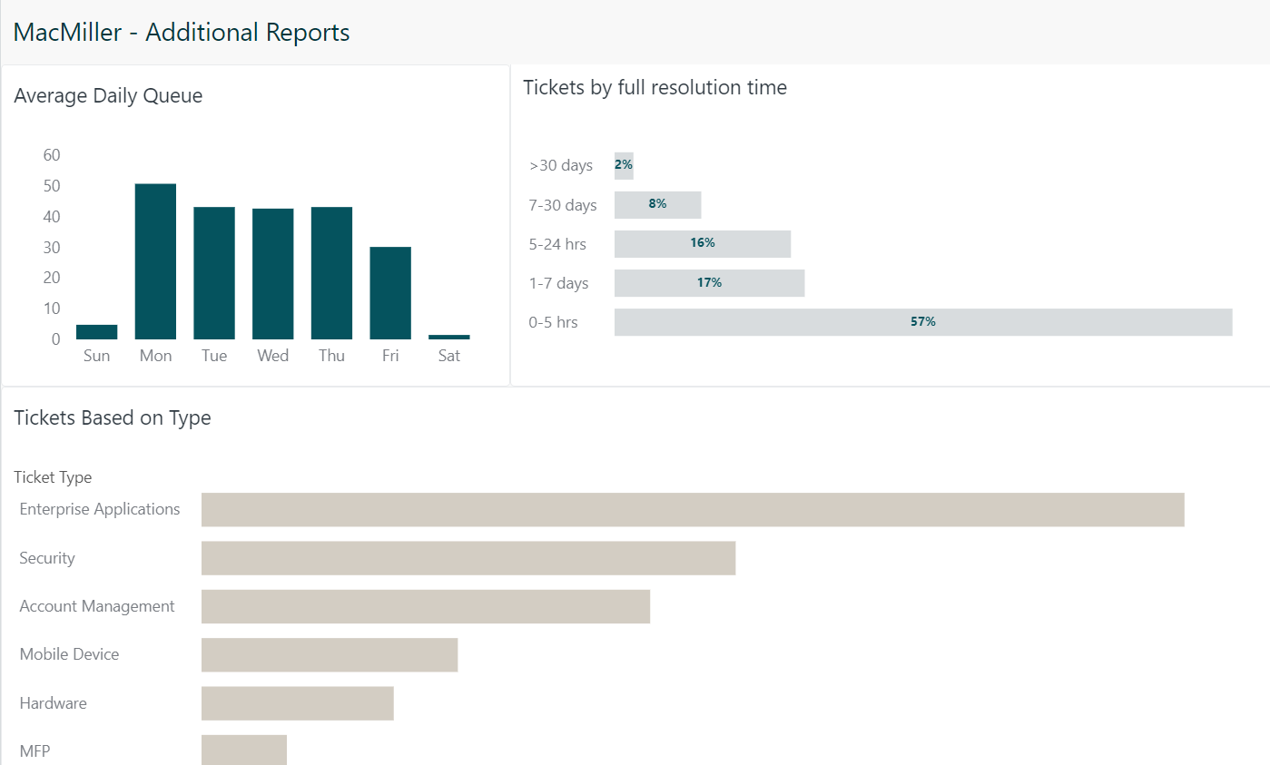
MacDonald-Miller – Zendesk Optimization
Client Need
MacDonald-Miller Facility Solutions is a full-service, design-build, mechanical contractor in the Pacific Northwest. The MacDonald-Miller team wanted to optimize Zendesk, their customer support platform to gain deeper analytics and reporting to support team workload, perfect their customer experience, identify trends etc.
What We Did
Affirma performed an audit and provided recommendations on features not being leveraged as well as what types of metrics and KPIs MacMiller should measure. Then, created new fields to categorize Zendesk support tickets and enable further information collection. Next, Affirma utilized custom reporting and tracking information to improve data collection and tailor insights for agents on the team.
Results
Team members are now able to more easily see all areas of ticket management, including response times, top performing agents, ticket topic category and trends. Furthermore, the team was able to drive increased accountability and efficiency when managing customer queries. With reoccurring issues, the team was able to act quickly and offer public facing articles to help guide customers and mitigate timely concerns.
"Affirma did a great job optimizing our ZenDesk platform. We now have custom reports and dashboards for better tracking, accountability and overall data to improve customer support." - Seth Henderson, IT Director

